Slide 1
Web and mobile app development – csc3054/7054
1.1 Introduction

Slide 2
Questions to be answered
What components does the module contain?
How is the module assessed?
Is this module involved in heavy programming?
Is the following statement correct? Why?
“A website is a venue of employing HTML scripts for specific applications. Therefore, a group of app will form a website.”
Which is not the major component of the Android System Architecture?
Applications
Application framework
Linux
Libraries
Android Runtime

Slide 3
Lecturer and teaching assistant
Lecturer
Dr. Huiyu (Joe) Zhou
E-mail: h.zhou@qub.ac.uk or h.zhou@ecit.qub.ac.uk
Office: Room 02.003, 8 Malone Road, office hours: Wednesday 13:00-15:00 or by appointment
Phone number: 028 90974875
Homepage: http://www.qub.ac.uk/schools/eeecs/Staff/BusinessCard/?name=H.Zhou
TA
Miss Narelle Allen
E-mail: n.allen@qub.ac.uk
Office: 01.015, Computer Science at Elmwood, Building 1
Phone number: 028 90975302

Slide 4
General info
Lectures/tutorials: 20/10 hours
Lectures: week 1 to week 10.
Tutorials: week 2 to week 11.
Please bring along your laptop so that we can program in the classroom while I am teaching.
Labs: 20 hours
Friday’ labs: week 2 to week 11.
Time allocation: 1-3 pm, Friday.
Formative quiz or questionnaire: every week.
To achieve well, at least 12-15 hours per week are expected for this module.

Slide 5
Lab sessions
Duration: Start from 12 February, 2016, and then run for 10 weeks.
Venue: ECS1/002/005 and ECS1/01/007 (capacity = 149).
Please bring along your student card with you if you want to use an Android tablet during a lab session.

Slide 6
General – continued
Course contents:
Android Application: Semantic elements, location and sensor management, data access, storage capability, user interface.
Mobile Web Development: Web design basics and practice.
Learning outcomes of this module:
Demonstrate the capability to design and implement basic Android Applications.
Be able to use HTML to create basic mobile web pages.
Develop the ability to adopt a critical approach for software designs.
Be able to document a given software design.
Be able to work independently towards the solution of a problem.

Slide 7
Assignments and exam
Late submissions to the assignments result in reduced marks – see the regulations…
Assessment: Exam paper – 50% (Android applications-40%; smartphone web development-10%); two lab exercises – 20% (each 10%); group project – 30%.
MSc students: at least 50 out of 100 in total in order to pass the course module.
Undergrad students: at least 40 out of 100 in total in order to pass the course module.
Exam style: Exemplar questions will be presented during lectures/tutorials/revisions. Students can find the past papers on-line.

Slide 8

Is this what we will be?

Slide 9
Entire picture of the module
Web and mobile application development:
Mobile web.
Web service.
Android application development.
Now we start from the first part – Android application development.

Slide 10
Content outline
Website and application
Categorisation of mobile devices
Android system architecture
Summary
Next lecture
Further readings

Slide 11
Website and application
A key question to be answered: What is the difference between a website and an application?

Slide 12

Website and application
Website
Browser-based HTML pages that are linked and accessed over the Internet.
Standard vs. mobile websites.
Exercise – which one refers to a mobile website?
www.qub.ac.uk
www.yahoo.co.uk
m.lifehacker.com

Slide 13
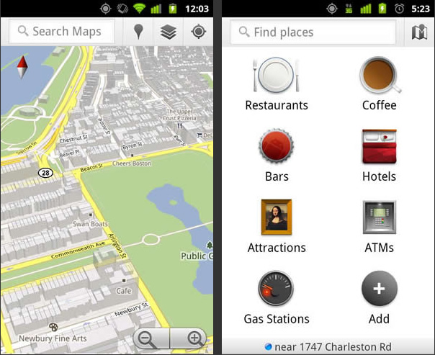
Website and application
Application
Abbreviation of application.
A piece of software that runs on mobile devices, the Internet or other e-devices.
Exercise – which one refers to an Application?
www.bbc.co.uk
https://maps.google.co.uk
Google Maps (see the right hand side)

Slide 14
Website and app
Does website or application have better properties as shown below?
Accessibility
Compatibility
Cost-effectiveness
Upgradability
Sustainability
Support
Personalisation

Slide 15
Content outline
Website and application
Categorisation of mobile devices
Android system architecture
Summary
Next lecture
Further readings

Slide 16
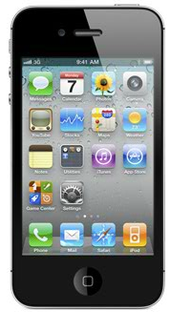
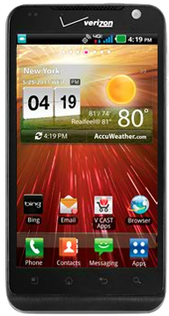
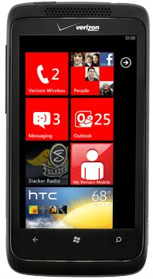
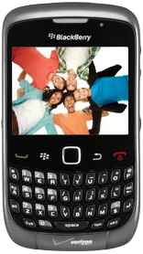
Categorisation of mobile devices
Families
Android
iOS: iPhone, iPad
Windows Phone
Chrome Store
HTML5 Webapp
Individual characteristics
Android: Customisable, open
iOS: Smart, close and stable
Windows Phone: Mixture of close and open sources
Blackberry: Good email app
iPhone 4
LG Revolution
HTC Trophy
BlackBerry Curve

Slide 17
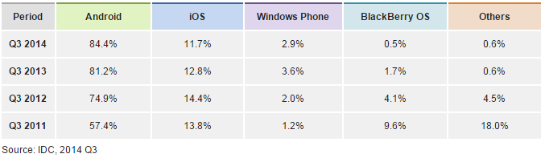
iOS or anDroid? Market reflection…
http://www.idc.com/prodserv/smartphone-os-market-share.jsp

Slide 18
Content outline
Website and app
Categorisation of mobile devices
Android system architecture
Summary
Next lecture
Further readings

Slide 19
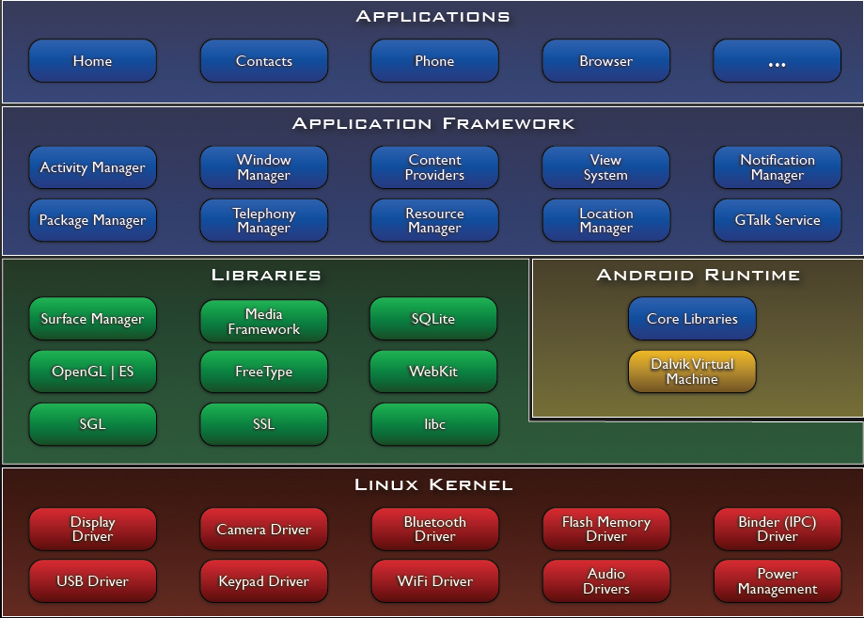
Android system architecture
http://developer.android.com/guide/basics/what-is-android.html

Slide 20
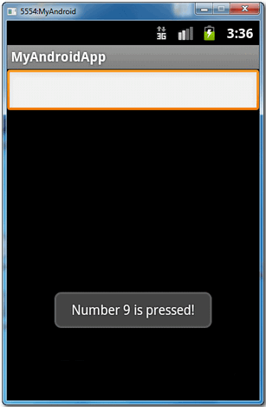
Application framework –
Views: To build an application, e.g. lists, grids, text boxes, buttons.

Slide 21
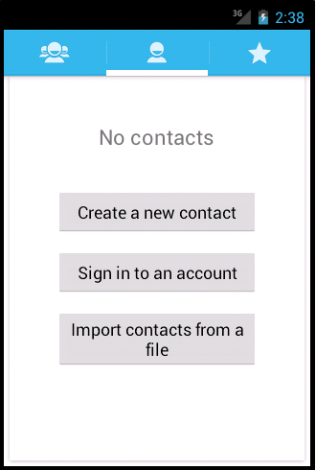
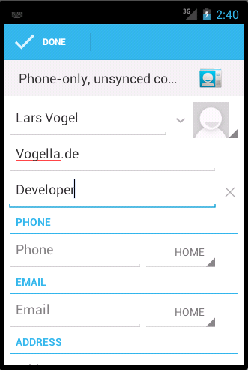
Application framework –
Content Providers: To access data from another application.

Slide 22

Application framework –
Resource Manager: Providing access to non-code resources such as localized strings, graphics and layout files.

Slide 23
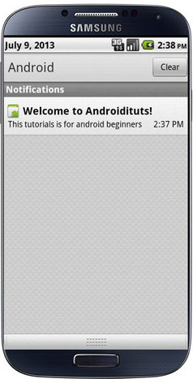
Application framework –
Notification Manager: To display custom alerts.

Slide 24
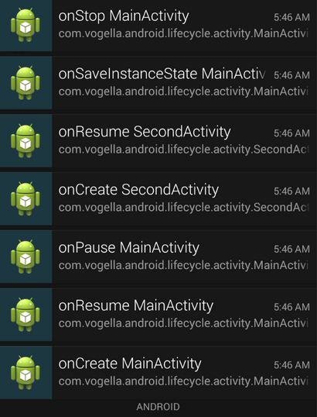
Application framework –
Activity Manager: To manage the lifecycle of applications.

Slide 25
Libraries –
Media libraries: Supports playback and recording of popular video and audio formats, e.g. JPG, PNG and MPEG4.
Surface manager: To manage display subsystem and 2d/3d graphic layers.
LibWebCore: Web browser engine.
SGL: 2-d graphic engine.
FreeType: Bitmap and vector font rendering.
SQLite: Database engine.

Slide 26
Android runtime –
A Java code, which implements the Android Application Programming Interface (API) for UI, data access, and other platform features.

Slide 27
Linux kernel –
Linux: Complete Linux distribution including GUI and other utilities.
Linux kernel: Operating system kernel used by the Linux family.

Slide 28
Content outline
Website and app
Categorisation of mobile devices
Android system architecture
Summary
Next lecture
Further readings

Slide 29
Summary
Please answer the questions raised before the lecture started today.
Module description.
Difference between website and app.
Components of Android system architecture.

Slide 30
Content outline
Website and app
Categorisation of mobile devices
Android system architecture
Summary
Next lecture
Further readings

Slide 31
next lecture
To set up a development environment for Android application development.
To start implementing an application.

Slide 32
Content outline
Website and app
Categorisation of mobile devices
Android system architecture
Summary
Next lecture
Further readings

Slide 33
Further readings
http://developer.android.com/training/index.html
Android Application Development for Dummies, Donn Felker, Wiley Publishing, Inc., NJ, 2011.

